Slide 1


CSB4301 – Theory of Computation
B.Tech – Vth Semester
Converting a RE into to Epsilon NFA
Mr. D.S.John Deva Prasanna AP(SG) & Ms.Vanathi, AP,CSE
Department of Computer Science and Engineering

Slide 2
Converting a RE into E NFA
Theorem
“Every Language Defined by an Regular Expression is also defined by a finite automata”
(every RE has an equivalent finite automata)

Slide 3
If L(R) defined by some regular expression R. We show L(R)=L(E) with some E NFA E with
Exactly one accepting state.
2. No arcs into the existing state.
3. No arcs out of the accepting state.

Slide 4
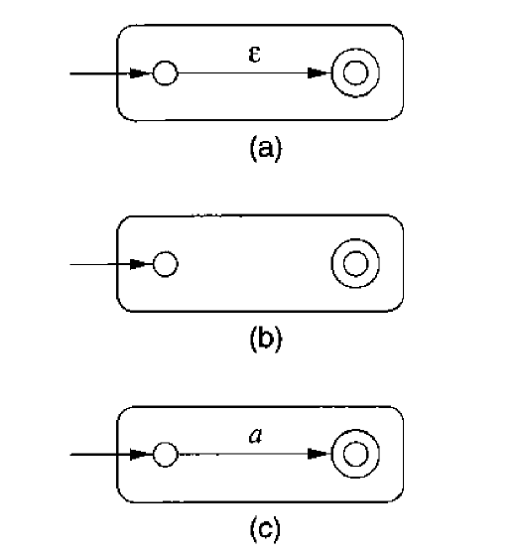
If ‘a’ is any alphabet then ‘a’ is a RE which represents the string ‘a’
Basis case
- single epsilon transition- ε
- no transition between the states – φ
- a transition with a single alphabet

Slide 5
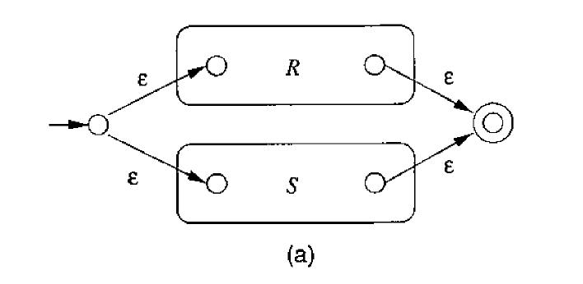
Structural Induction on R and S (obtaining R+S from the REs ‘R’ & ‘S’)
The two REs ‘R’ and ‘S’ and we combine them with ‘OR ‘then this automata serves.
The resultant regular expression is R+S.
The language obtained in L(R) υ L(S)

Slide 6
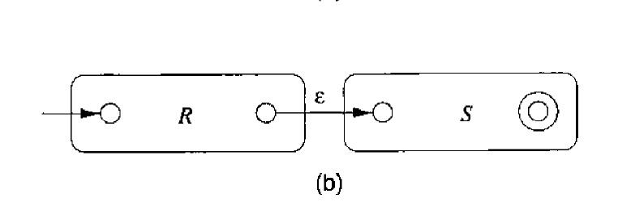
Structural Induction on R and S (obtaining R.S from the REs ‘R’ & ‘S’)
The two REs ‘R’ and ‘S’ and we combine them with ‘AND ‘then this automata serves.
The resultant regular expression is R.S
The language obtained in L(R) L(S)

Slide 7
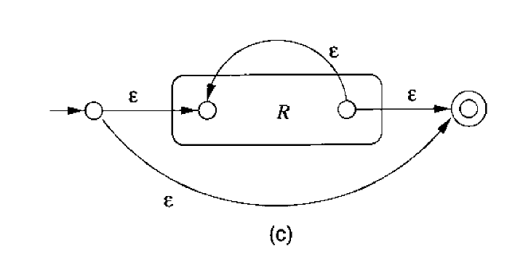
Structural Induction on R (obtaining R* from the RE ‘R’ )
The REs ‘R’ is can be extended to include R *by this automata.
The resultant regular expression is R*
The language obtained in L(R*)=
= L(R), L(R).L(R), L(R).L(R).L(R), ….

Slide 8
Note
As said previously in Rules for generating RE
A pair of enclosing parenthesis will not change the language this automata represents.
There is no need for a separate automata for the RE (R).
The RE which is deduced for RE ‘R’ is sufficient.

